Slide 1
Concurrent and Parallel Systems Thread pooling
Dr Sergio Davies <sergio.davies@shu.ac.uk>
Department of computing
Sheffield Hallam University
21 October 2022

Slide 2
Teaching schedule
LECTURES |  | LABS
Date | Topic | Date | Topic
30 Sep | Introduction to concurrency Introduction to threads in C++ Mutex variables | 27 Sep | Practical example of parallel computing Simple matrix multiplication
7 Oct | Time analysis in multithreaded software Return values from threads | 4 Oct | Multithreaded matrix multiplication – 2 approaches
14 Oct | Condition Variables Concurrency patterns Producer/consumer | 11 Oct | Evaluation of multi-threading speed-up
21 Oct | Assignment description Thread pooling | 18 Oct | std::async / std::future / std::promise experiments Dining philosophers problem
28 Oct | Thread prioritisation – R/W Locks Coursework support | 25 Oct | Producer/consumer pattern – unidirectional and bidirectional communications
4 Nov | Coursework support | 1 Nov | Coursework support
11 Nov | Coursework support | 8 Nov | Coursework support

Slide 3
Topics
Last week: Producer/Consumer pattern
Today:
Thread pooling pattern

Slide 4
Programming patterns
Reusable solution to a commonly occurring problem in software design in a given context;
Usually an abstract version that can be easily transformed in the required code;
Has already been studied and implemented, and reduces the possibility of design flaws or coding errors;
Do you think this applies to the Producer/Consumer pattern?

Slide 5
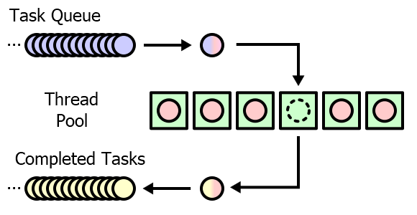
Thread pool pattern
A pool of thread is available, but sleeping on a condition variable;
When a new task arrives, a thread is awaken and receives the task;
When the task is completed, the thread returns to sleep;

Slide 6
Thread pool
Advantages:
No need to instantiate a new thread for each task;
Execution time reduced;
Non need to allocate/deallocate system memory for the new thread;
Reduces memory fragmentation (if that is a problem);
Disadvantages:
More memory occupied for “sleeping” threads;
“Spurious” wakeups bound to consume some computation cycles;
More complex software development;
How do you know how many threads effectively run tasks?

Slide 7
Definition of the class
class ThreadPool {
public:
ThreadPool(size_t);
template<class F, class... Args> auto enqueue(F&& f, Args&&... args) -> std::future<typename std::result_of<F(Args...)>::type>;
~ThreadPool();
private:
std::vector< std::thread > workers;
std::queue< std::function<void()> > tasks;
std::mutex queue_mutex;
std::condition_variable condition;
bool stop; };
The pool contains a vector to keep a handle for all threads and a queue to store incoming tasks
When initialised, the thread pool requires a number for the number of threads in the pool
Queueing the task requires a template as the return value and the parameters of the task are unknown before compilation

Slide 8
Definition of the class
class ThreadPool {
public:
ThreadPool(size_t);
template<class F, class... Args> auto enqueue(F&& f, Args&&... args) -> std::future<typename std::result_of<F(Args...)>::type>;
~ThreadPool();
private:
std::vector< std::thread > workers;
std::queue< std::function<void()> > tasks;
std::mutex queue_mutex;
std::condition_variable condition;
bool stop; };
Main development difficulty is that the task function can have an arbitrary number and type of parameters and (possibly) a return value (also this has an arbitrary type);
The return value is an std::future object: a value which will be filled in the future, during the execution

Slide 9
Definition of the class
class ThreadPool {
public:
ThreadPool(size_t);
template<class F, class... Args> auto enqueue(F&& f, Args&&... args) -> std::future<typename std::result_of<F(Args...)>::type>;
~ThreadPool();
private:
std::vector< std::thread > workers;
std::queue< std::function<void()> > tasks;
std::mutex queue_mutex;
std::condition_variable condition;
bool stop; };
The task function may also be part of a class;
Function “Enqueue” receives a pointer to the task function and the parameters.

Slide 10
Example usage
int workerThread(int i)
{
std::cout << "hello world " << i << std::endl;
std::this_thread::sleep_for( std::chrono::seconds(3));
return i*i;
}
The task here is just to print “Hello world”, with a number that is passed from the caller and return the squared value of that input parameter;
Input parameter: int i;
Output parameter: int i*i;

Slide 11
Example usage
int main() {
ThreadPool pool(4);
std::vector< std::future<int> > results;
auto sleeptime = std::chrono::seconds(5);
for(int i = 0; i < 8; ++i) {
auto worker = pool.enqueue(workerThread, i);
results.emplace_back(std::move(worker)); }
std::this_thread::sleep_for(sleeptime);
std::cout << std::endl;
for(auto && result: results) {
std::cout << "result (int) " << result.get();
std::cout << std::endl; }
std::cout << std::endl;
return 0;}
Thread pool initialised with 4 threads;
8 tasks to complete;
Wait 5 seconds;
Retrieve and print result of each thread;

Slide 12
Thread pool coding guidelines
The thread pooling class is taken from Jakob Progsch and Václav Zeman’s work: https://github.com/progschj/ThreadPool
A youtube video for those who are interested in how to develop a thread pool object can be found here: https://www.youtube.com/watch?v=eWTGtp3HXiw

